Slide 1
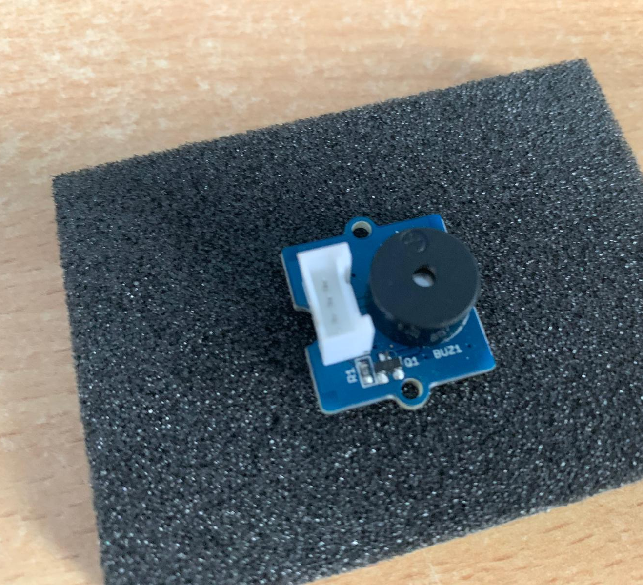
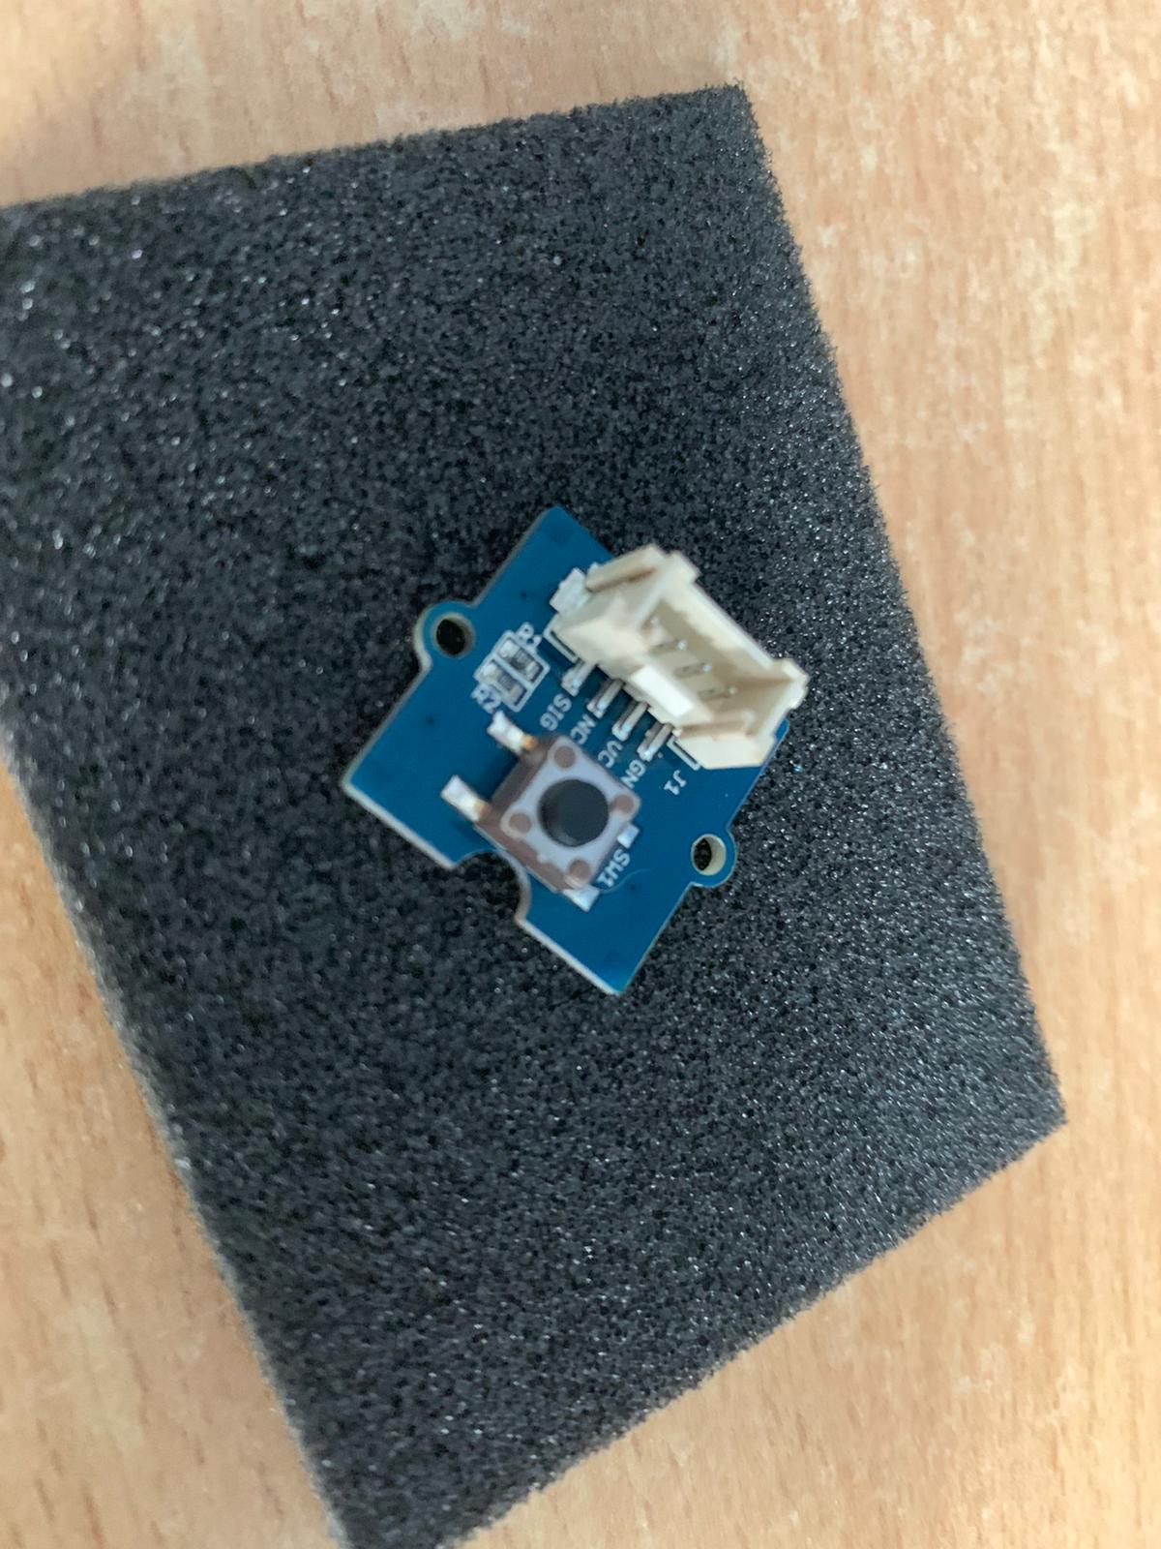
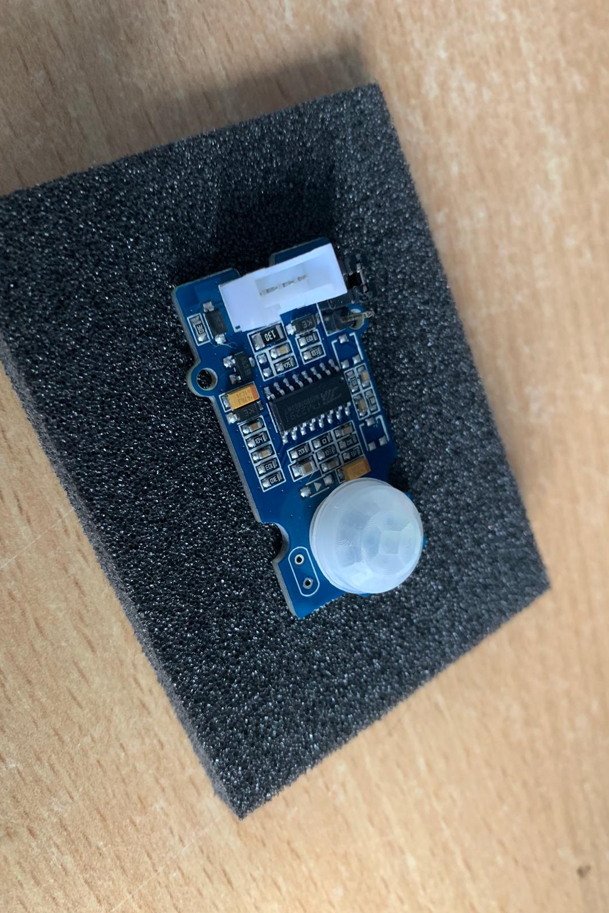
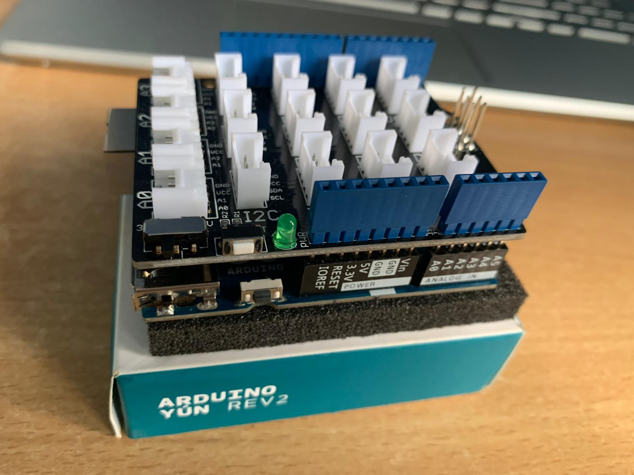
Arduino Yun Hand Sanitizer Project
By Jamie Bredin, Sean Henry, Rian Bolger, Ariane Dos Santos

Slide 2

Brief
Help minimize the spread of Covid-19.
API – to track how many people sanitize their hands in business environment.
Coding .
Bring in suggestions from lecturer and classmates from our last presentation.

Slide 3

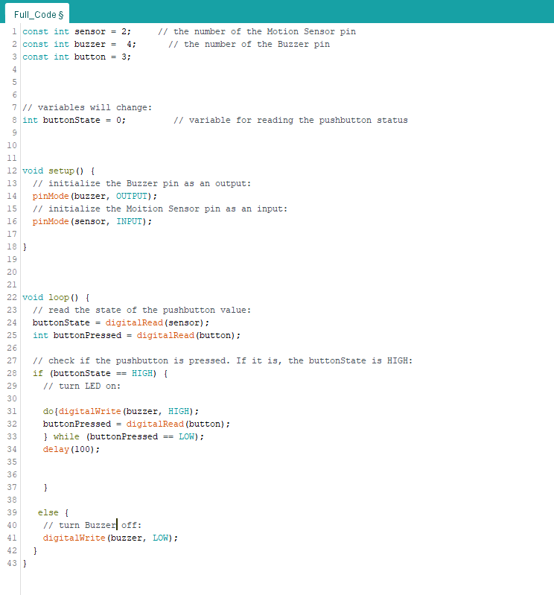
Mention Code ?

Slide 4

Introducing API to our project

Slide 5


How it works

Slide 6

Demo Video?

Slide 7

What didn’t work?

Slide 8

Security Risks

Slide 9

Project Learning Outcome

Slide 10

Future

Slide 11

Feedback and Questions

